Slide 1




Final Project
MIS-584 Business Intelligence
(Fall 2024)
Team 01
Veronica Madepogu
Rama Raju
Shahbaz Shah Khan
Keerthan T Selvan
Sai Ajethaa
Notes:
1

Slide 2



Presentation Roadmap
Conclusion & Summary
Project Overview
Three Use Cases / Prototypes
Proposed BI Solution
BI Solution Implementation
Notes:
2

Slide 3

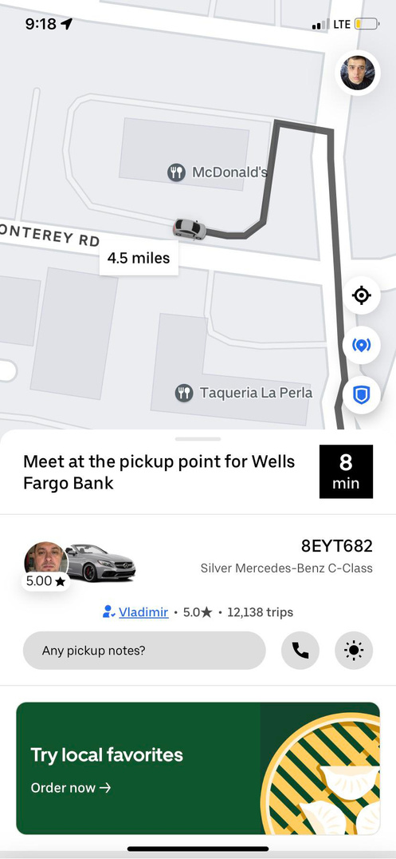

Client Background
Name: Uber Technologies, Inc.
Industry: Transportation and Technology
Products/Services: Ride-hailing services, food delivery (Uber Eats), freight services, and micro-mobility (e.g., bikes and scooters).
Geographic Market Area: Operates in over 900 metropolitan areas worldwide.
Size: Approximately 30,400 employees (2023).
Total Equity: US$12.028 billion (2023) ​
Departments/Business Units: Key departments include Operations, Product Development, Marketing, Customer Support, and Engineering. ​

Slide 4
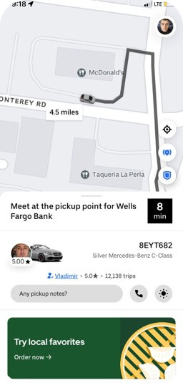
The Problem and its relevance
🚨 Problem Statement:
Uber faces driver unavailability and high cancellation rates, especially for airport-city trips, causing:
Lost revenue.
Reduced reliability.
Customer dissatisfaction.
🔗 Project Relevance:
Solves operational inefficiencies using Uber’s data.
Enhances reliability and driver availability.
Supports competitive growth in a dynamic market.

Slide 5
Project Overview
A comprehensive analysis of Uber’s operational challenges using advanced BI tools.
Focus areas:
Airport-City Trips: Addressing driver unavailability and ride cancellations.
Operational Performance: Enhancing revenue and trip efficiency.
​🎯 Goals:
Operational Efficiency: Align supply-demand & minimize idle time.
Customer Satisfaction: Reduce cancellations & delays.
Market Dynamics: Predict demand & optimize pricing
📊 Deliverables:
Dashboards: Real-time insights into revenue, cancellations, and trip efficiency.
Recommendations: Driver incentives, pre-booking, and dynamic pricing.
🔑 Key Findings:
Peak issues: Morning city cancellations & evening airport unavailability.
Revenue potential lost due to supply-demand mismatches.
🌟Impact: Improved reliability, increased revenue, and enhanced customer experience.
Notes:
3

Slide 6









Current status of the use of reporting and business intelligence/analytics systems in the Uber
Previous BI tools
Data Warehouse
Information System
Data Lifecycle Management (DLM)
Hadoop
Uber initially used Hadoop but faced latency issues with large data.
They optimized using Presto for real-time, Hive for analytics.
Hive
Integrates Various Data Sources
Vertica
Support Real time data Processing
Ensure efficient data lifecycle operations
Notes:
Primarily Uber used tools
> Hadoop – It is a open source software designed for storing and processing large data sets
> Hive - With the help of SQL language for analysing large data sets and data summarization.
Vertica – It is analytical data base designed for big data and helps in providing actionable insights.
Uber uses data warehouses and has implemented several technologies to manage its vast data infrastructure. Uber's data platform processes over 100 petabytes, utilizing technologies like Presto, Hive, and Hadoop to handle its massive data needs.
Uber originally used Hadoop's HDFS to manage the storage of large amounts of data, but it faced latency and scalability challenges due to the inefficiencies of batch processing. To optimize, Uber adopted a hybrid approach using multiple warehouse solutions, including Presto for real-time queries and Apache Hive for analytics. By 2017, Uber had redesigned its platform to support faster, incremental data ingestion and address the scalability issues of its growing data stores. The company also utilizes advanced optimization strategies, such as minimizing operational costs by identifying underused tables and redirecting queries to more efficient platforms like Presto
> Vertica – It is analytical data base designed for big data and helps in providing actionable insights.
Coming to the IS
Uber utilizes integrated information systems to manage various aspects of its operations, particularly in the realm of data infrastructure and lifecycle management. For example, Uber has developed a unified Data Lifecycle Management (DLM) system that integrates policy management, execution, monitoring, and auditing across multiple datastores. This system ensures seamless policy enforcement, deconfliction, and dataset management, leveraging metadata and business policies across the organization. The system operates on Uber's extensive cloud infrastructure, interacting with different cloud providers while maintaining a centralized view of the data (
Uber
).
Additionally, Uber's "Crane" infrastructure stack showcases the use of seamless integration between cloud and on-premise servers. This system abstracts the specific details of whether a server is cloud-based or on-prem, allowing seamless operation across different platforms. The Crane system's assignment and provisioning processes are fully integrated, allowing Uber teams to scale and manage resources without manual intervention. This results in a flexible and robust infrastructure that supports Uber's rapid expansion and global operations (
7

Slide 7


Uber has a dedicated Business Intelligence team transforming data insights.
The team turns raw data into actionable business insights effectively.
Data integration, analysis, and reporting drive Uber's BI efforts.
Position of Uber BI Maturity Model
Uber sits at an advanced BI maturity level with advanced infrastructure.
In-house BI platforms like Gairos, Presto, Pinot ensure scalability.
Notes:
Yes, Uber currently has a dedicated business intelligence (BI) team. Uber has invested heavily in building a robust BI platform to manage the vast amounts of data it generates daily. This platform, called the "Business Intelligence Suite," is designed to support employees across various departments with different levels of data expertise. This includes data scientists, business analysts, product managers, and engineers.
Uber's BI platform helps the company democratize data, making it accessible to employees globally, regardless of their technical background. The BI team plays a crucial role in maintaining and evolving this platform, ensuring seamless integration across tools and generating insights that help drive Uber’s operations and strategy. They also focus on automating insights using machine learning to improve decision-making.
Uber sits at a mature level on the Business Intelligence (BI) maturity model, characterized by advanced data infrastructure, real-time analytics, automation, and comprehensive decision-making systems. Uber has developed in-house solutions for BI, focusing on scalability and efficiency through platforms such as Gairos, Presto, and Pinot, which support vast amounts of real-time data, dynamic pricing, and operational decision-making.
Uber's BI infrastructure not only supports self-service analytics for various stakeholders across the organization, but also integrates machine learning for predictive analytics. Their data platform processes over 100 petabytes of data, handling millions of queries, which aligns with the top levels of BI maturity. Their commitment to real-time decision-making and sophisticated data governance (like Databook for metadata management) further solidifies their position in the mature stage of BI development
8

Slide 8



PRESTO
Presto is an open-source SQL engine enabling complex queries on datasets.
It supports ETL, data exploration, and federated queries for Uber.
APACHE POINT
Apache Pinot supports real-time, low-latency analytics for Uber's service dashboards.
It enables real-time monitoring of orders for Uber's taxi service.
Notes:
Yes, Uber uses specific Business Intelligence (BI) tools and reporting systems to manage its data and provide insights. One of the main tools Uber relies on is Presto, an open-source distributed SQL query engine. Presto allows Uber to run complex queries on large datasets stored in their data lake. It is particularly useful for ETL (Extract, Transform, Load) processes, data exploration, and self-service analytics. Presto's ability to handle federated queries, combining data from various sources, has been essential for Uber's analytical needs.
Additionally, Uber integrates Apache Pinot to support real-time analytics for low-latency use cases. This helps in providing real-time dashboards like the Restaurant Manager for their Eats service, which allows restaurant owners to monitor orders as they come in.
Furthermore, Uber has developed its Gairos platform, which focuses on real-time data intelligence by processing and optimizing real-time data flows and integrating with systems like Apache Kafka and Elasticsearch. This system helps Uber in dynamic pricing, trip forecasting, and other real-time services.
These systems are part of Uber’s broader BI infrastructure, ensuring seamless data-driven decision-making across the company.
9

Slide 9


Proposed BI Solution
Objective: Address operational inefficiencies, optimize revenue, and enhance customer satisfaction through actionable insights.
Dashboards
Airport-City Trips Dashboard: Insights on cancellations and driver availability.
Operational Performance Dashboard: Monitor revenue trends and trip efficiency.
Analytics:
Social media sentiment analysis to understand customer feedback.
Outcome:
Reduce cancellations and driver unavailability.
Optimize revenue through peak demand management.
Enhance customer satisfaction with data-driven improvements.
Notes:
12

Slide 10
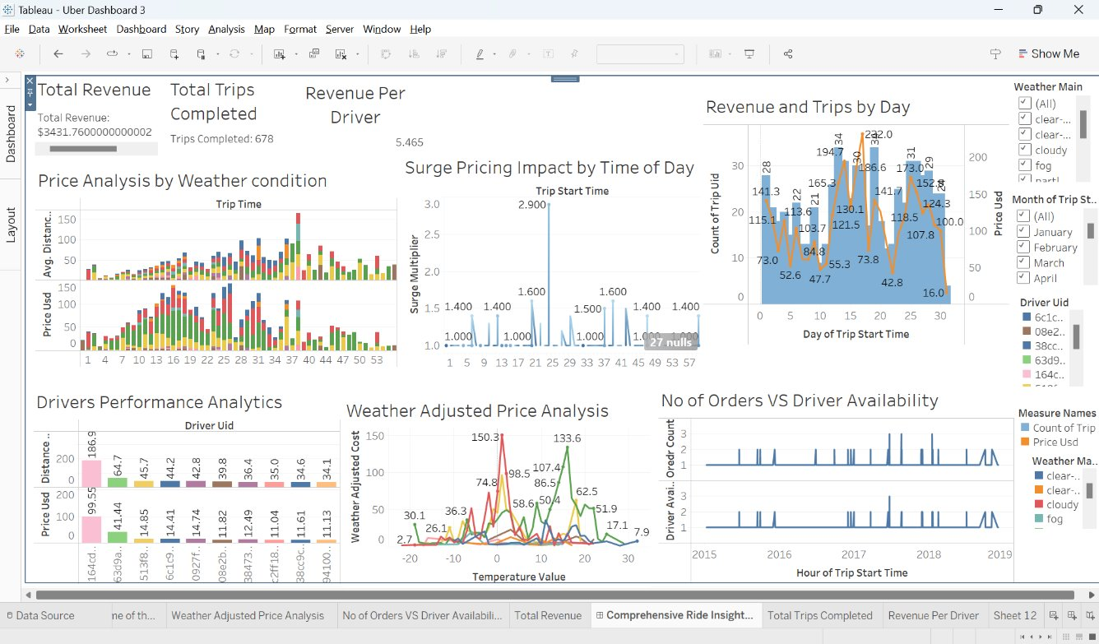
Comprehensive Ride Insights of Uber (Use Case 1)
This dashboard provides a holistic view of Uber's operational and financial performance. It emphasizes the following key insights:
Notes:
10

Slide 11
Key Insights from Dashboard
Revenue Trends:
Revenue peaks during specific times
2. Driver Management:
Identifying top-performing drivers and aligning availability with demand ensures operational efficiency and customer satisfaction
3. Impact of External Factors:
Weather and temperature significantly affect trip costs and duration, necessitating dynamic adjustments to pricing strategies.
4. Operational Efficiency:
Analyzing trip efficiency by comparing distance, time, and pricing highlights areas for improvement in driver routing and fare structure.
→This dashboard empowers Uber to make data-driven decisions that enhance revenue, optimize operations, and improve both driver and customer experiences.
Key charts from Dashboard
Price Analysis by Weather condition :-
This chart highlights how different weather conditions affect ride prices.
2. Number of Orders vs. Driver Availability
comparing the number of trips (Order Count) against available drivers over time.
3. Revenue and Trips by Day:
This chart correlating total revenue and trip counts on a daily basis.
4. Driver Performance Analysis (Revenue and Distance): This chart helps ranking drivers based on their revenue and distance contributions.
5. Total Revenue, Total Trips Completed, and Revenue per Driver
Summary KPIs at the top of the dashboard:
Total revenue generated and Average revenue per driver.
Total trips completed.
Notes:
10

Slide 12
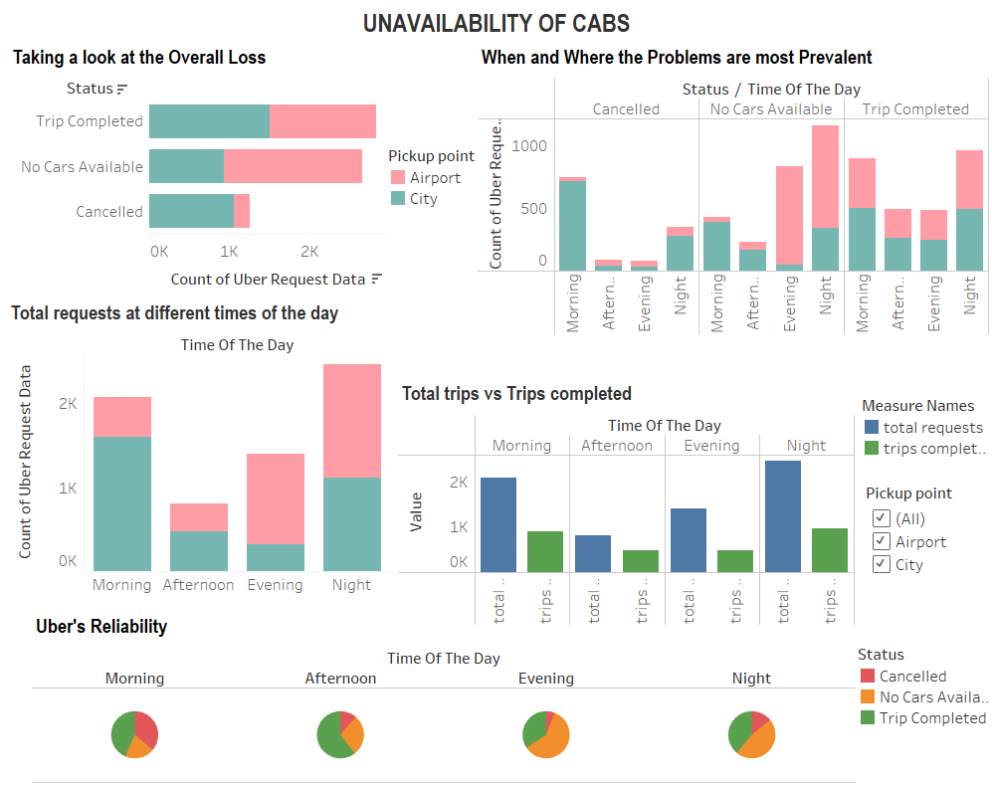

Use Case 2
Notes:
10

Slide 13
Key Insights from Dashboard
Problems:
Missing out on potential revenue
Risk of losing customers
Reputation at stake – Unreliable
Solutions:
Identify reasons for cancellations and address driver concerns.
Analyse when drivers are most needed at the airports and when drivers are most needed to bring people to airports from cities.
provide incentives ; bonuses or salary boosts for drivers.
impose penalties on drivers for accepting and then cancelling requests.
Cluster Analysis to find nearest busy locations and direct cabs for airport pickups.
Set up separate stand for Uber at airport.
Notes:
10

Slide 14
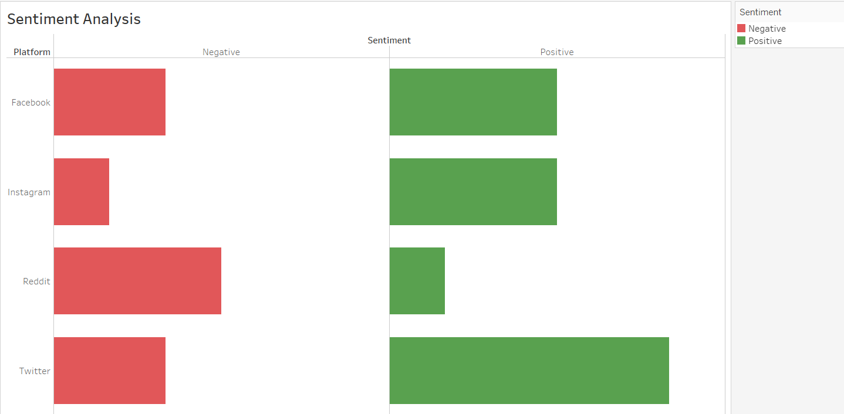




Social Media Analytics (Sentiment Analysis)
Komprehend | World Class NLP APIs for Text Analysis
Notes:
10

Slide 15
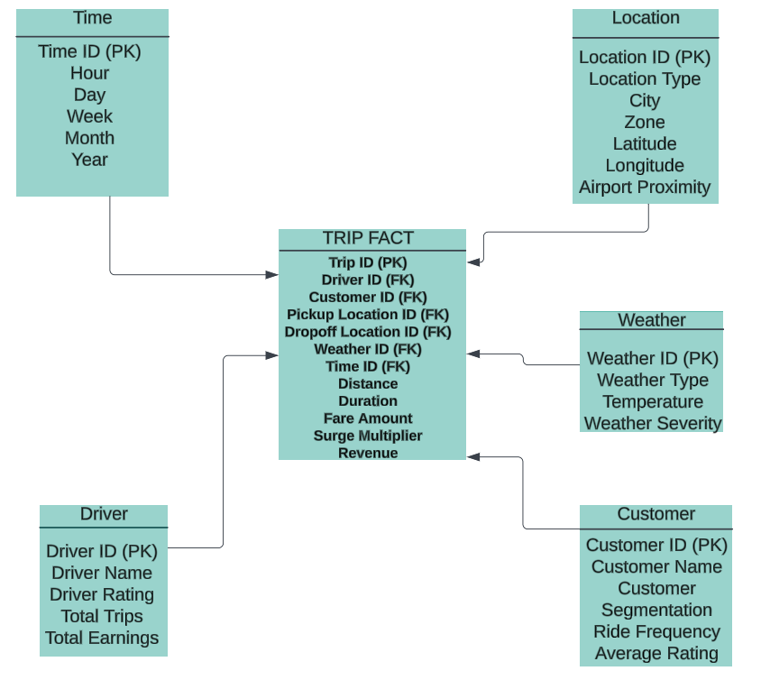

Data Warehouse (Star Schema)
Notes:
10

Slide 16

Implementation Plan and Recommendations
Managerial Follow Kotter’s Eight-Step Model for transformation. Train teams on dashboards and empower decision-making. Launch dashboards addressing cancellations and revenue first for quick wins. | Technical Use ETL to extract, clean, and load data from rides, drivers, weather, and social media. Address data quality issues like duplicates and missing values. Implement real-time data integration to support proactive decision-making.
Ethical Anonymize customer and driver data to ensure privacy. Comply with GDPR/CCPA and mitigate bias in predictive models. Maintain transparency in data usage policies. | Recommendations Begin with dashboards solving immediate issues (cancellations, driver availability). Scale to predictive analytics and sentiment analysis. Establish a governance framework for ethical and effective data usage.

Slide 17
Kotter’s Eight Steps for Implementing BI Solution
Step | Action | Outcome
1. Establish a Sense of Urgency | We must address critical issues such as high cancellation rates, driver unavailability, revenue leakage, and declining customer sentiment. These challenges directly impact our revenue and reputation. | Creates momentum across teams by making it clear why implementing a BI solution is critical right now.
2. Form a Powerful Guiding Coalition | We will build a cross-functional team with key stakeholders from operations, customer service, finance, marketing, and BI specialists. | Ensures everyone is aligned, engaged, and committed to the success of the BI solution.
3. Create a Vision for Change | Together, we’ll define a clear vision for how BI will optimize operations, enhance customer satisfaction, and drive revenue growth through data-driven insights. | Provides us with a shared goal and ensures everyone understands how BI supports our success.
4. Communicate the Vision | We’ll use presentations, workshops, and success stories to show how BI dashboards and analytics can solve our operational challenges. | Gains alignment and excitement from all levels of the organization about our BI transformation.
5. Empower Others to Act on the Vision | By providing hands-on training and resources, we’ll ensure that our managers and teams can effectively use dashboards and interpret analytics results. | Empowers our teams to make faster, smarter decisions with confidence.
6. Create Short-Term Wins | Our first win will come from the Airport-City Trips Dashboard, which will immediately improve driver allocation and reduce cancellations. | Builds trust and confidence in the BI solution by demonstrating early successes.
7. Consolidate Gains and Produce More Change | We’ll expand the solution to include the Operational Performance Dashboard and Social Media Analytics to address additional needs. | Reinforces the BI solution as a valuable tool for both operational and strategic decision-making.
8. Anchor the Changes in Organizational Culture | We’ll embed BI-driven insights into our daily operations, performance reviews, and strategic planning processes. | Makes BI a natural and integral part of how we operate and make decisions.
Notes:
11

Slide 18
Kotter’s Eight Steps (brief) for Implementing BI Solution
Step | Brief Action
1. Integrate BI into daily operations, strategy, and performance reviews. | Address high cancellations, driver unavailability, and revenue loss to highlight the need for BI.
2. Form a Powerful Guiding Coalition | Build a team from operations, marketing, finance, and BI experts to drive implementation.
3. Create a Vision for Change | Define how BI improves operations, enhances customer satisfaction, and grows revenue.
4. Communicate the Vision | Use workshops and presentations to demonstrate BI’s value and align stakeholders.
5. Empower Others to Act on the Vision | Train teams to use dashboards and analytics for better decision-making.
6. Create Short-Term Wins | Deploy the Airport-City Trips Dashboard to show immediate operational improvements.
7. Consolidate Gains and Produce More Change | Expand BI to include the Operational Performance Dashboard and Social Media Analytics.
8. Anchor the Changes in Organizational Culture | Integrate BI into daily operations, strategy, and performance reviews.
1
Notes:
11

Slide 19
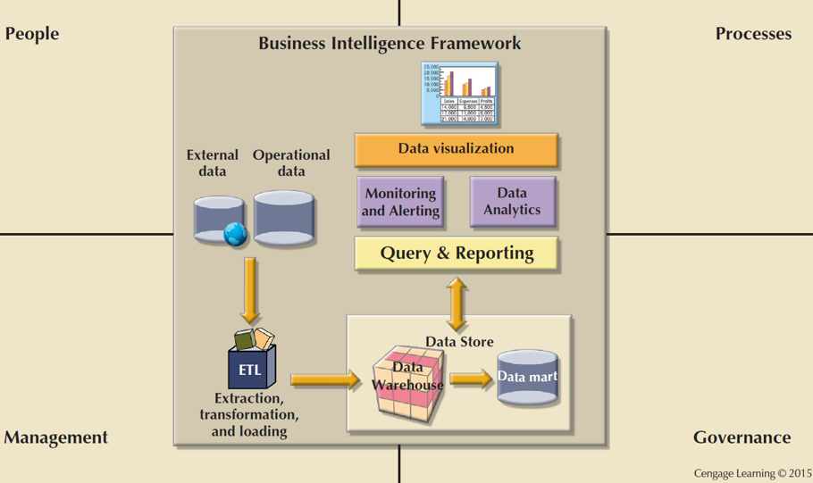
BI Framework
Notes:
11

Slide 20

Conclusion & Summary
Challenges Addressed: Resolved cancellations, driver unavailability, and revenue inefficiencies impacting Uber’s operations.
Solutions Implemented: Developed dashboards for cancellations and revenue trends, performed sentiment analysis, and integrated real-time BI processes.
Approach Taken: Applied ETL pipelines, predictive analytics, and data visualization tailored to Uber’s needs.
Results Achieved: Improved driver availability, reduced cancellations, optimized revenue, and enhanced customer satisfaction.

Slide 21

References of Datasets Used
a) Prototype 1 dataset:
uber_dataset 1.xlsx
https://github.com/Priyachakraborty/Uber_data_analysis/blob/master/uber_dataset.csv
b) Prototype 2 dataset:
https://wpi0my.sharepoint.com/:x:/g/personal/vmadepogu_wpi_edu/ESjhZAnLgStEnNmo0rqBhBEBluFdXnoUSBPrDY87iKjDUg?e=3G6vHa
c) Social Media Analytics dataset:
https://wpi0my.sharepoint.com/:x:/g/personal/vmadepogu_wpi_edu/EaLeXtxbwJFDhy4PQ1dDe-kB59I7xvo7zUzeHJLKYSm3HQ?e=BZIPz6

Slide 22

Thank you

